Slide 1
Real Estate Sales Price Prediction Project
Predictive Modeling for Enhanced Real Estate Valuation
Presented By: Donn Bryan Julian
Date: 12/05/2024

Slide 2
Project Overview
Goal:
Predict real estate sales prices using historical data.
Scope:
Focused on properties from 2001 to 2022, using a variety of statistical and machine learning methods to develop an accurate prediction model.
Key Takeaway:
The best model has an R-squared of 0.949, demonstrating strong predictive capabilities.

Slide 3
Source Data
Data Source:
Acquired from https://catalog.data.gov/dataset/real-estate-sales-2001-2018 covering real estate sales between 2001-2022.
Details:
Over 1 million records with features like assessed value, property type, town, and sale amount.

Slide 4
Exploratory Data Analysis (EDA) Overview
Objective:
Understand data distribution, identify outliers, and recognize relationships.
Initial Insights:
Data contains multiple types, non-uniform missing values, and varying distribution across categorical features.

Slide 5
Data Cleansing
Actions Taken:
Removed towns with fewer than 500 entries to eliminate noise.
Dropped non-numeric fields like 'Address' and 'Date Recorded' that didn't contribute to prediction.
Outcome:
Focused on significant features to enhance model performance.

Slide 6
Statistical Tests Conducted
Multicollinearity (VIF Analysis):
Identified and removed highly correlated features to reduce redundancy.
Autocorrelation: Performed Ljung-Box test to verify residual independence.
Heteroskedasticity: Breusch-Pagan test confirmed minimal variance issues.
Normality: Applied Lilliefors and Shapiro-Wilk tests; deviations from normality informed the selection of ensemble models.

Slide 7
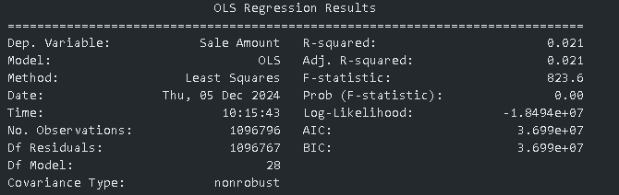
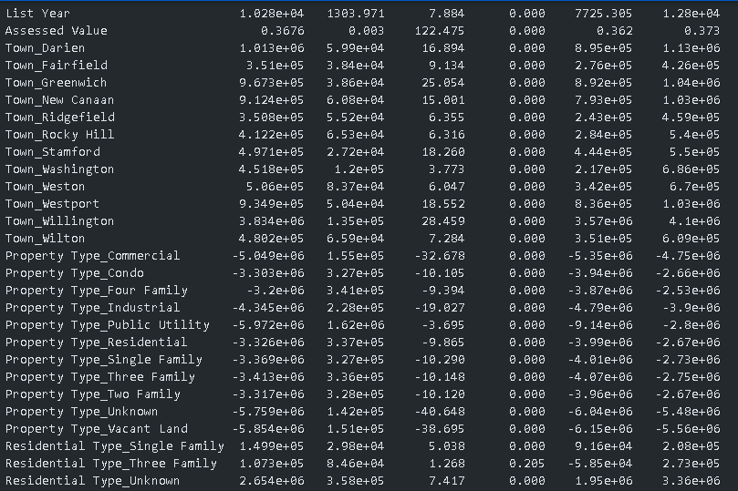
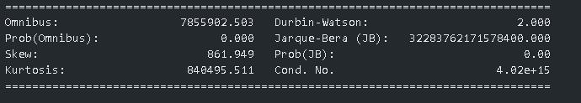

Slide 8
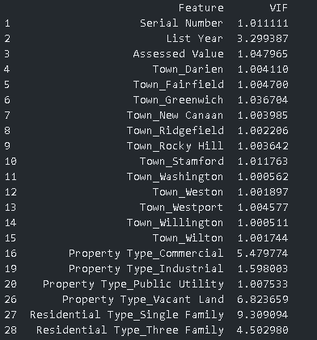
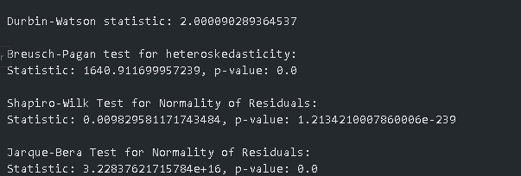
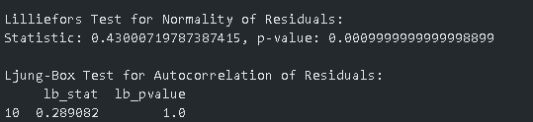

Slide 9
Feature Selection Techniques
Variance Thresholding:
Removed features with low variance that provided little predictive information.
ANOVA F-test:
Dropped statistically insignificant features.
Outcome:
Reduced dimensionality to retain the most impactful predictors.

Slide 10
Data Preparation
One-Hot Encoding:
Converted categorical features like 'Town' to dummy variables.
Sampling:
Used 10% of the dataset to speed up the model training.
Final Dataset Size:
Over 100,000 records used for modeling.

Slide 11
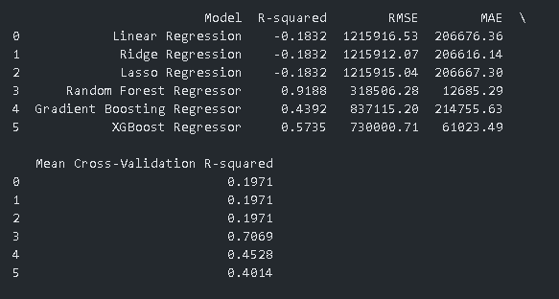
Model Testing and Selection
Models Tested:
Linear Regression, Ridge, Lasso, Random Forest, Gradient Boosting, XGBoost.
Selection Criteria:
R-squared, RMSE, and MAE for performance evaluation.

Slide 12
Model Performance Overview
Random Forest Results:R-squared: 0.9042
Root Mean Squared Error (RMSE): 345,908
Mean Absolute Error (MAE): 11,250
Insight: Random Forest was the best-performing model, indicating strong predictive power.

Slide 13
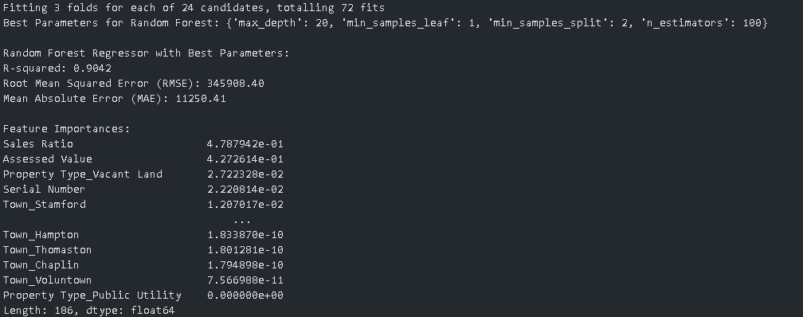
Random Forest Model - Detailed Evaluation
Cross-Validation: Average R-squared of 0.788 across 5-fold validation.
Residual Analysis: Confirmed no visible pattern in residuals—indicative of a well-fitting model.

Slide 14
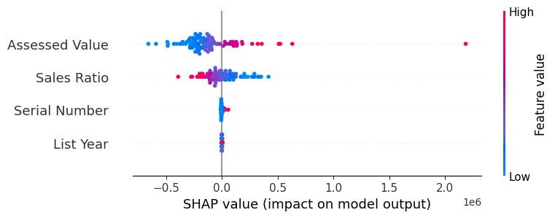
Understanding Predictions with SHAP
SHAP Analysis:
Key features driving model predictions were Assessed Value and Sales Ratio.
Interpretation:
SHAP values help visualize each feature’s contribution—red bars indicate higher values pushing the prediction up, while blue reduces it.
This provides transparency into model decision-making, aligning predictions with real-world expectations.

Slide 15
Deployment Preparation
Model Packaging:
Saved the model as a .pkl file.
Deployment Plan:
Created a REST API using Flask for real-time predictions.
Future deployment on Hugging Face for broader accessibility.

Slide 16
Business Insights & Next Steps
Insights Gained:
Key predictors like Assessed Value can be leveraged for targeted marketing and strategic pricing.
Next Steps:
Deploy the model on Hugging Face.
Monitor performance and plan for retraining.

